Slide 1
Automation of Human-Robot Collaboration
Joshua Vahala
With Bilge Mutlu and Rob Nowak

Slide 2
Overview
Prior Work
Current Progress
Next Steps

Slide 3
Prior Work
Understanding what makes good human-robot handovers.
Chien-Ming Huang, Maya Cakmak, Bilge Mutlu. “Adaptive Coordination Strategies for Human-Robot Handovers”. Robotics: Science and Systems XI, 2015.

Slide 4
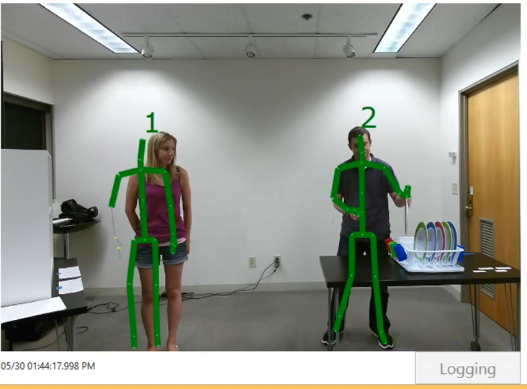
Modeling Process – Handover with High Task Load

Slide 5
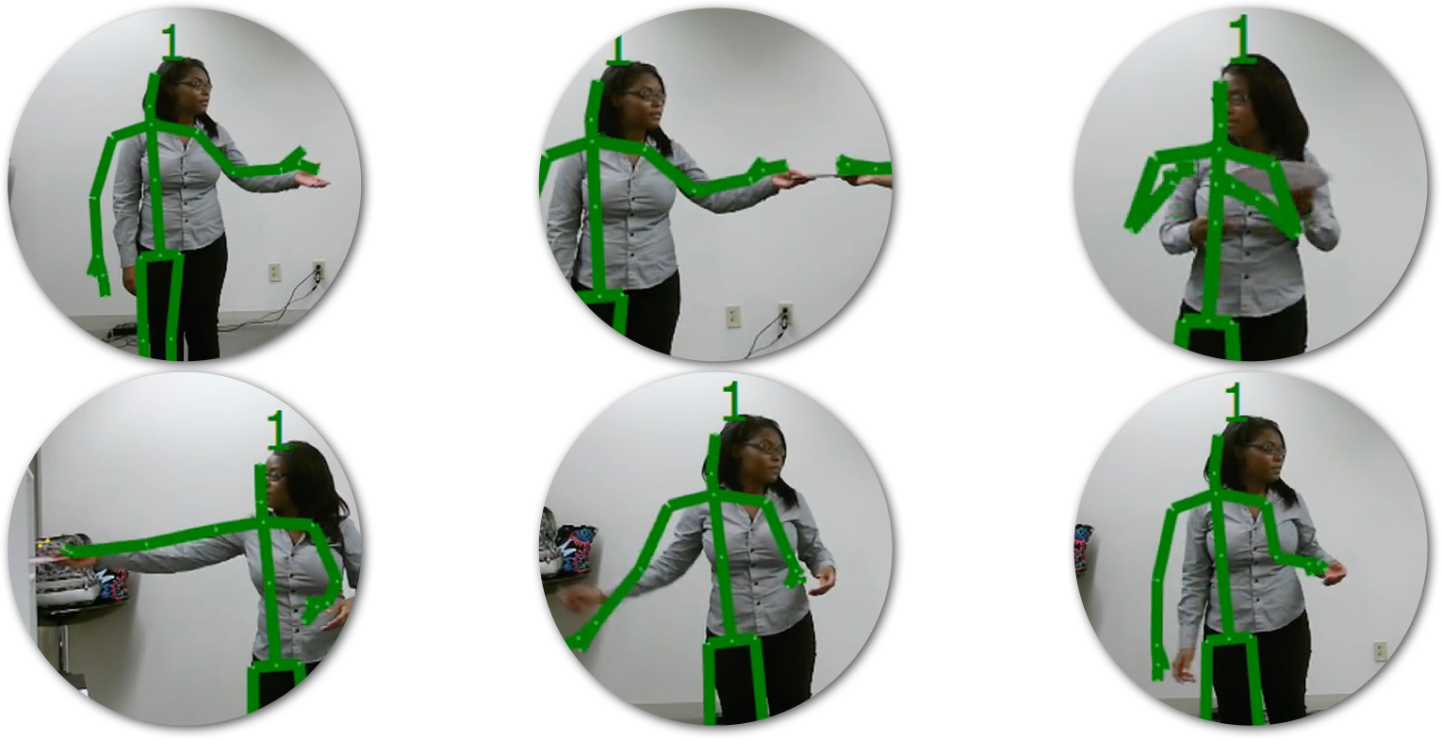
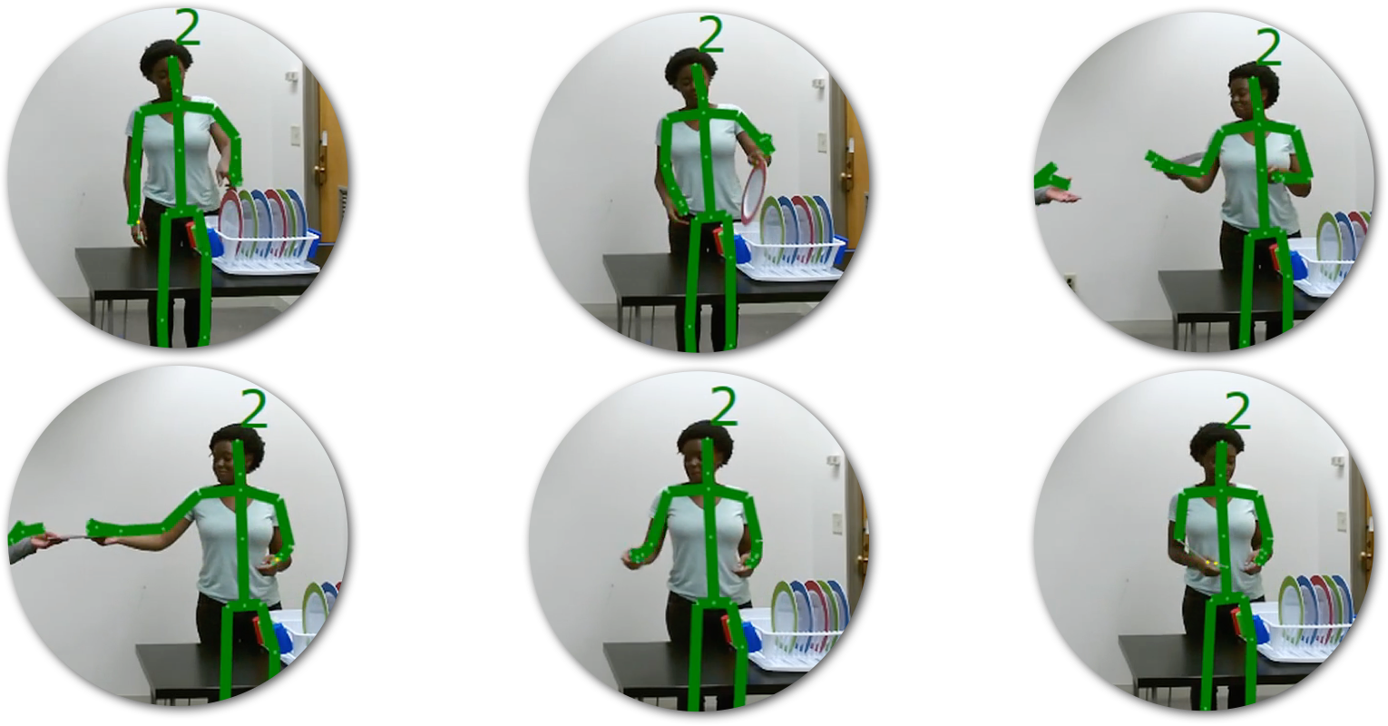
Modeling – States are hand labeled and used as training data
Receiver States
Giver States
1. Take
2. Handover
3. Retrieve
1. Reach
2. Retrieve
3. Give
4. Place
5. Retract
6. Idle
4. Handover
5. Retract
6. Idle

Slide 6
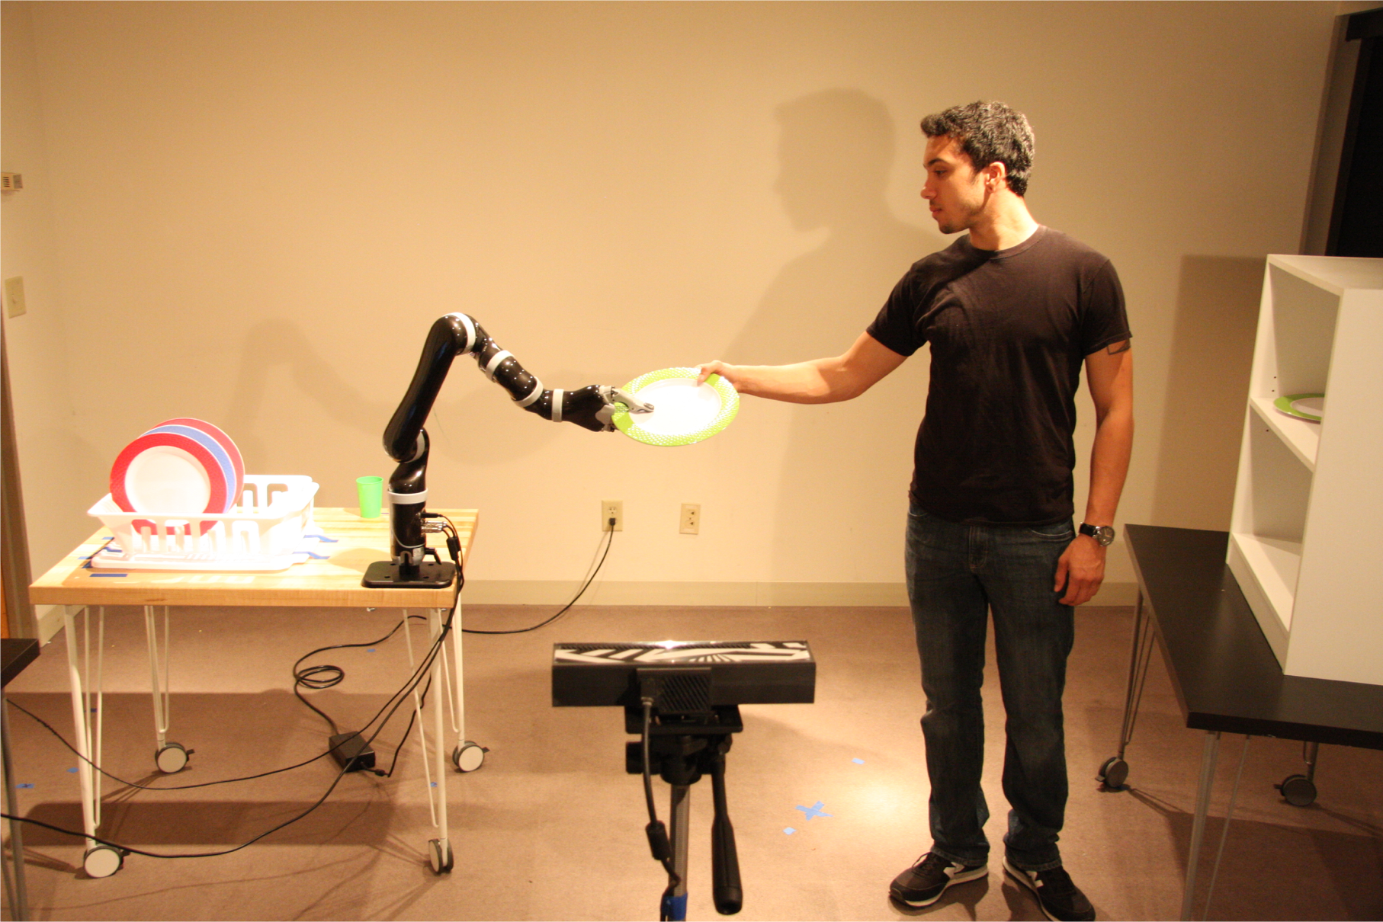
Implementation – Setup
Three handover strategies: proactive, reactive, adaptive
Two tasks loads: low, high
Human receiver
Robot giver
Recognition Camera
(Kinect)
During these Giver states

Slide 7

Coordination Strategies

Slide 8
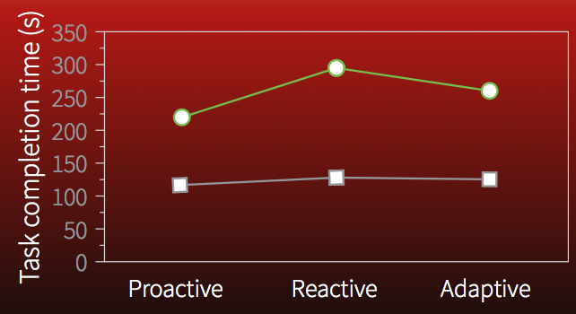
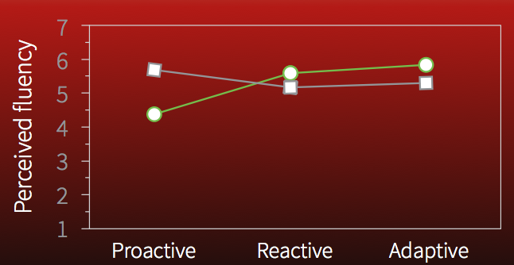
Evaluation
With an adaptive robot model…
User experience is optimized
Performance is negatively affected (compared to proactive model)
Tradeoff between UX and Performance seems worth it
Team Performance
User Experience

Slide 9
Big Limitations!
Results required extensive manual effort acquiring / labeling training data.
Defined states are not generalizable to other collaborative tasks.
Grab object
Place object
Math problem

Slide 10
Current Progress
Addressing limitations.

Slide 11
Algorithm Overview
Watch Full Task
Choose Features
Interjoint, joint-to-midpoint distances
Define States
Spectral clustering (also defines a primary subspace for our points to lie on)
Get New Features
Classify Current State
(according to known tasks)
Probabilistic* kNN using historically labeled data and expected state-transition-paths
task not complete
Estimate Completion Time
Based on estimated position along expected state-transition-path
Update Robot Position
Trajectory is predefined for a task – timing along the path is the variable of interest
task complete
Update States
Project new features onto the primary subspace and redefine states for the particular task

Slide 12
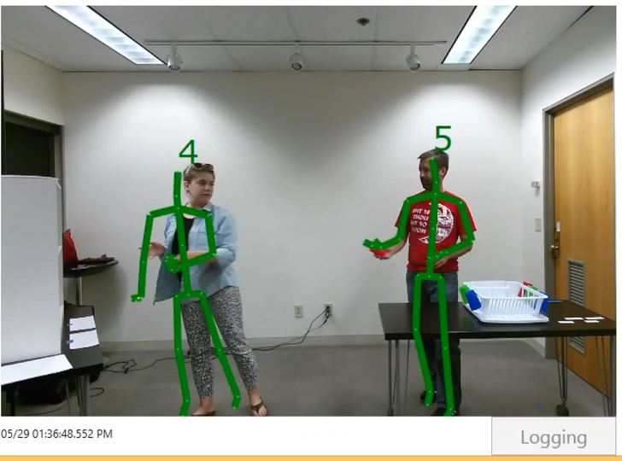
Handover Classification Results – Base Video

Slide 13
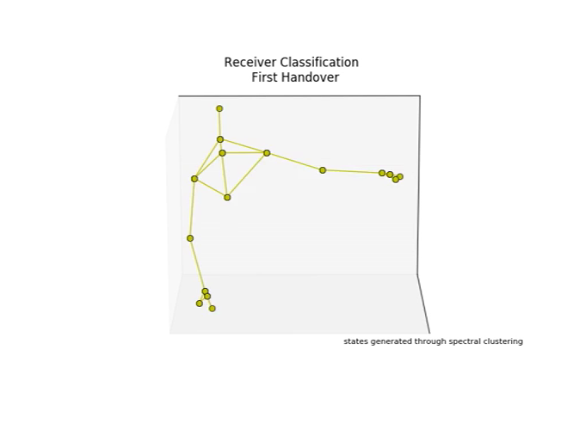
After Watching Initial Handover
[----2----] [1] [---------0---------] [1] [------------2------------] [-----1-----]
Notes:
-----------------------------------
After first viewed task:
-----------------------------------
[----2----][1][---------0---------][1][------------2------------][-----1-----]
labels:
[ 2. 2. 2. 2. 2. 2. 2. 2. 2. 2. 2. 2. 2. 2. 1. 1. 1. 1.
0. 0. 0. 0. 0. 0. 0. 0. 0. 0. 0. 0. 0. 0. 0. 0. 0. 0.
0. 0. 0. 0. 0. 0. 0. 0. 0. 0. 0. 1. 1. 1. 2. 2. 2. 2.
2. 2. 2. 2. 2. 2. 2. 2. 2. 2. 2. 2. 2. 2. 2. 2. 2. 2.
2. 2. 2. 2. 2. 2. 2. 2. 2. 2. 2. 2. 2. 2. 1. 1. 1. 1.
1. 1. 1. 1. 1. 1. 1. 1. 1. 1. 1. 1. 1.]
-----------------------------------
Online classification of next task through kNN:
-----------------------------------
PATH: [2, 1, 0, 1, 0, 1, 0, 1, 0, 2, 0, 2, 1]
times; [0, 0, 0, 0, 0, 0, 0, 0, 0, 0, 0, 0, 0]
addstate (threshold): 0.15
proportions: [0.20000000000000001, 0.40000000000000002, 0.20000000000000001, 0.10000000000000001, 0.10000000000000001]
[-1. -0.014 0.023 1. ]
PATH: [2, 1, 0, 1]
times; [0, 0, 0, 0]
stateshape: (3, 2) numstates: 3
[-1. -0.01 0.019 1. ]
[-2-][-1-][----------0----------][1][---0---][1][0][1][--0--][-----2-----][--0--][--2--][1]
labels:
[2, 2, 2, 2, 2, 2, 2, 2, 2, 2, 1, 1, 1, 1, 1, 1, 1, 0, 0, 0, 0, 0, 0, 0, 0, 0, 0, 0, 0, 0, 0, 0, 0, 0, 0, 0, 0, 0, 0, 0, 0, 0, 0, 0, 0, 0, 0, 0, 0, 0, 0, 0, 0, 0, 0, 0, 0, 0, 0, 0, 1, 1, 0, 0, 0, 0, 0, 0, 0, 0, 0, 0, 0, 0, 0, 0, 0, 0, 0, 1, 0, 1, 0, 0, 0, 0, 0, 0, 0, 0, 0, 0, 0, 0, 0, 0, 2, 2, 2, 2, 2, 2, 2, 2, 2, 2, 2, 2, 2, 2, 2, 2, 2, 2, 2, 2, 2, 2, 2, 2, 2, 2, 0, 0, 0, 0, 0, 0, 0, 0, 0, 0, 0, 2, 2, 2, 2, 2, 2, 2, 2, 2, 2, 2, 2, 1, 1]
-----------------------------------
After second task completes and states are updated:
-----------------------------------
contracting
removing 44 elements
adding the important addtions back
distwidth (threshold): 1.4
addstate (threshold): 0.156
proportions: [0.26000000000000001, 0.20799999999999999, 0.436, 0.056000000000000001, 0.040000000000000001]
[-1. -0.585 0.312 1. ]
stateshape: (3, 2) numstates: 3
PATH: [2, 1, 0, 1, 2, 1]
times; [0, 0, 0, 0, 0, 0]
PATH: [2, 1, 0, 1, 2, 1]
times; [0, 0, 0, 0, 0, 0]
unique path length values : [6]
cnts of unique path lengths : [2]
[----2----][-1-][----------0----------][1][-----------2-----------][-----1-----]
New expected path after update:
[----2----][-1-][----------0----------][1][-----------2-----------][-----1-----]
PATH: [2, 1, 0, 1, 2, 1]
times; [0, 0, 0, 0, 0, 0]
Second task path definition ground truth:
[----2----][-1-][----------0----------][-1-][----------2----------][-----1-----]
labels:
[ 2. 2. 2. 2. 2. 2. 2. 2. 2. 2. 2. 2. 2. 2. 2. 2. 2. 2.
2. 2. 1. 1. 1. 1. 1. 1. 1. 1. 0. 0. 0. 0. 0. 0. 0. 0.
0. 0. 0. 0. 0. 0. 0. 0. 0. 0. 0. 0. 0. 0. 0. 0. 0. 0.
0. 0. 0. 0. 0. 0. 0. 0. 0. 0. 0. 0. 0. 0. 0. 0. 0. 0.
0. 1. 1. 1. 1. 1. 1. 1. 2. 2. 2. 2. 2. 2. 2. 2. 2. 2.
2. 2. 2. 2. 2. 2. 2. 2. 2. 2. 2. 2. 2. 2. 2. 2. 2. 2.
2. 2. 2. 2. 2. 2. 2. 2. 2. 2. 2. 2. 2. 2. 2. 2. 1. 1.
1. 1. 1. 1. 1. 1. 1. 1. 1. 1. 1. 1. 1. 1. 1. 1. 1. 1.
1. 1. 1.]

Slide 14
Online State Classification vs. Ground Truth (second handover task)
Initial Handover State-Transition Path (103 frames):
[----2----] [1] [---------0---------] [1] [------------2------------] [-----1-----]
Online State Classification of second task via kNN (147 frames):
[-2-] [-1-] [----------0----------] [1] [---0---] [1] [0] [1] [--0--] [-----2-----] [--0--] [--2--] [1]
[-2-] [-1-] [------------------0------------------] [-----2-----] [--0--] [--2--] [1]
(corrected for noise)
Ground truth classification for second task (147 frames):
[----2----] [-1-] [----------0----------] [-1-] [----------2----------] [-----1-----]
Updated State-Transition-Path after viewing both tasks and updating states:
[----2----] [-1-] [----------0----------] [1] [-----------2-----------] [-----1-----]

Slide 15
State Update
Initial Handover State-Transition Path:
[----2----] [1] [---------0---------] [1] [------------2------------] [-----1-----]
[----2----] [-1-] [----------0----------] [1] [-----------2-----------] [-----1-----]
Updated State-Transition-Path after viewing both tasks and updating states:

Slide 16
Next Steps
Probabilistics, Robot implementation

Slide 17
Probabilistics
Mixed Rayleigh distribution to scale the counts of nearest neighbors coming from kNN to prefer states that correspond to the expected state-transition-path.
Issues related to scaling, moving to new states, number of nearest neighbors to consider…

Slide 18
Robot Implementation
Vrep?
What collaborative tasks could be good to test generalizability?
Notes:
Turning on a faucet for a user with a cup that only has one arm free

Slide 19
Appendix

Slide 20
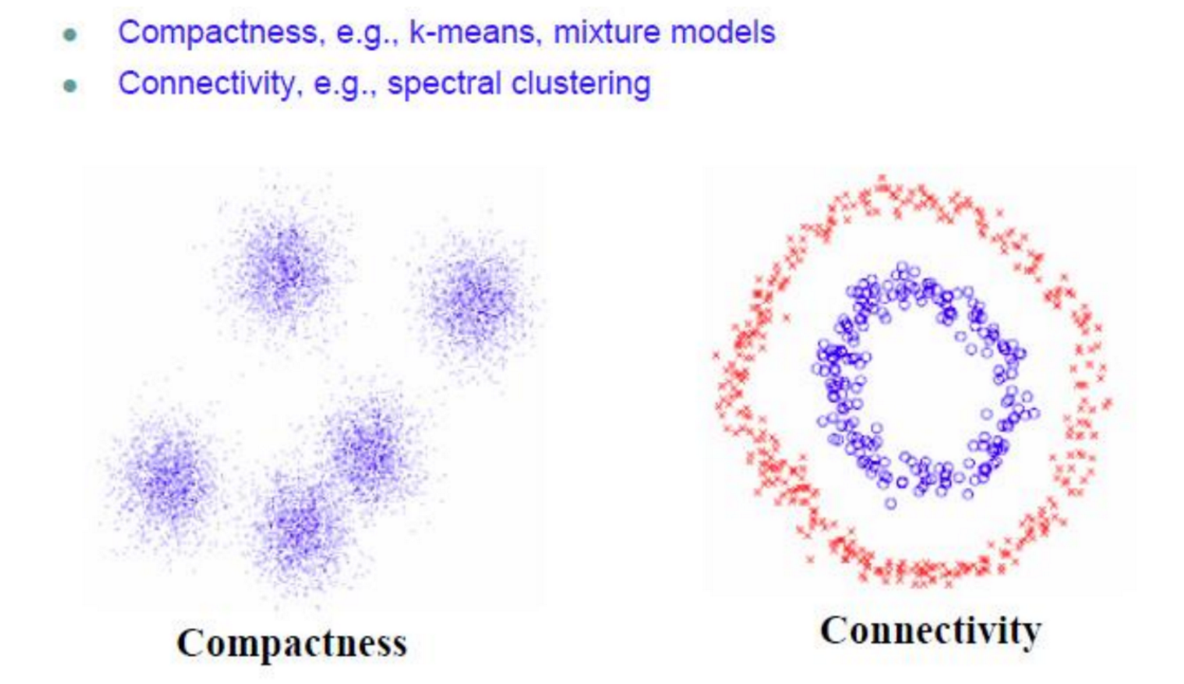
How do we define states?
Spectral Clustering – unsupervised learning
Image credit: https://charlesmartin14.wordpress.com/2012/10/09/spectral-clustering/

Slide 21
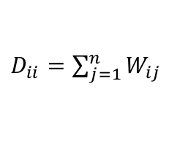
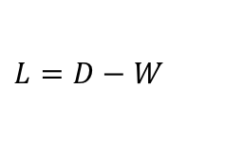
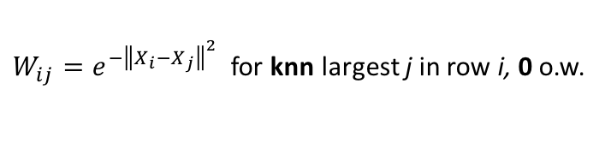
Spectral Clustering Algorithm
Input: X = (n x p) feature array, knn = # nearest neighbors, k = number of clusters, d = embedding dimension
Output: Z = (n x 1) group labels, C = (k x d) locations of group centers
Compute W, Similarity Matrix from X
Compute D, the Degree Matrix from W
Compute L, the Laplacian Matrix from W and D
Compute SVD of L (one or more singular values will be 0)
Using the basis vectors associated with the d smallest singular values, use kmeans++ to return the Z and C.
$W_{ij}=e^{−{\left\|X_{i}−X_{j}\right\|}^{2}}$for knn largest j in row i, 0 o.w.
$D_{ii}=\sum_{j=1}^{n}{W_{ij}}$
$L=D−W$

Slide 22
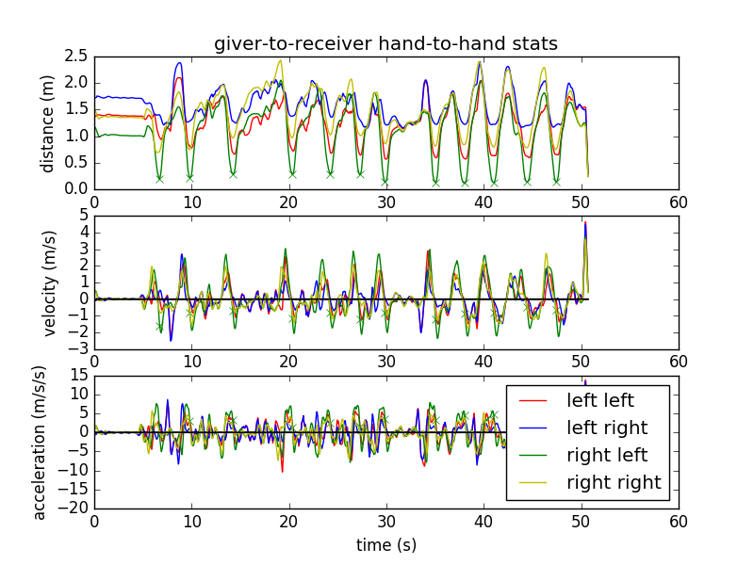
Defining Handovers by Data
Looks for minimum distance between hand pairs along with low velocity and high acceleration

Slide 23
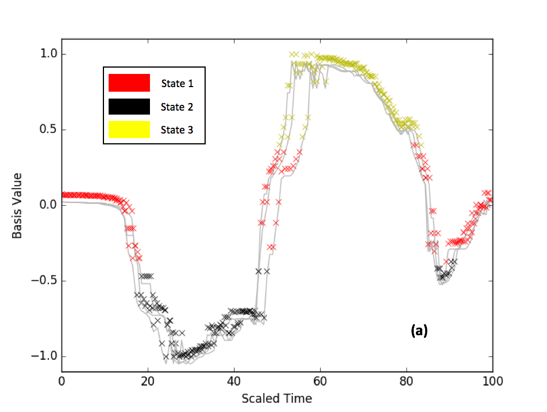
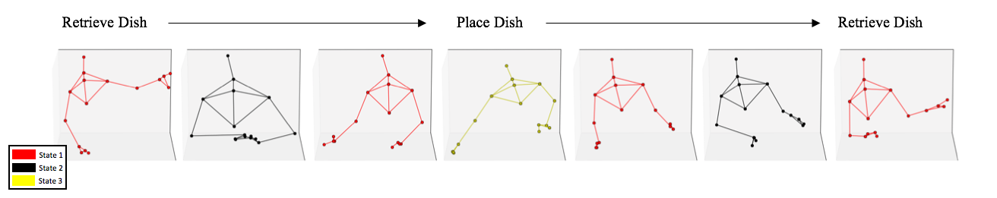
Primary Basis / State Definition
Example of three different handover paths projected onto the primary 1D basis scaled to the same total time.

Slide 24
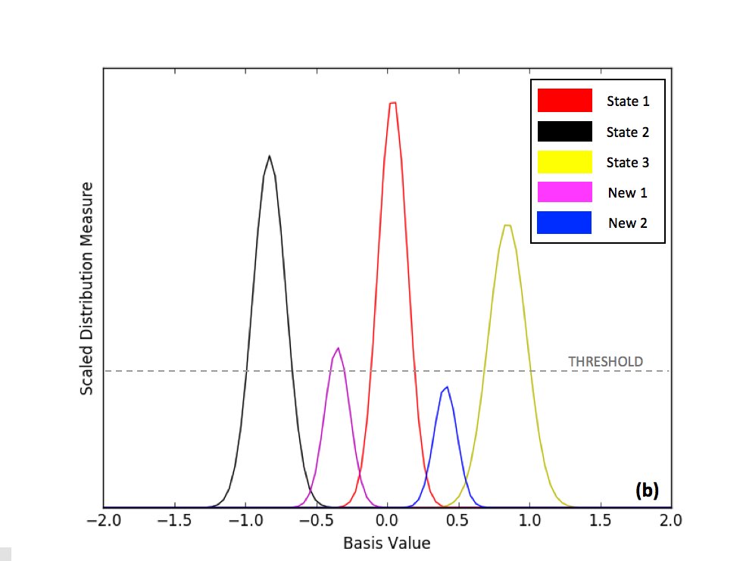
State Updates
New states are added if they meet some threshold dependent on the number of points within each potential state.

